Slide 1
PUBLICITY
Name: Suraj Rajesh Maurya
PGIMAC

Slide 2
Basic Principle of Publicity
Creativity – Use fresh ideas, gimmicks, unusual shapes, and pictures.
Variety – Use different techniques to target different people.
Quantity – Put Publicity your target audience will see it the most (eg : bathrooms, doors, mailboxes)

Slide 3
Basic Principle of Publicity
Legibility – It’s not going to work if people can’t read it ( even if you do put it everywhere)
Understandability – Be concise and clear, and use vocabulary your target will understand.
Time – If publicity goes up to early, your target will forget, if it goes up too late, you won’t get a good response.

Slide 4
Example Timeline
10 days before – teasers in bathrooms or on doors
7 days before – advertise in school paper or residence hall newsletter
5 days before – flyers around hall
3 days before – word of mouth campaign begins
1 day before – last minute reminders like chalking sidewalks, walking the halls, making announcement.

Slide 5
Traditional Publicizing Techniques
Posters
Flyers
Banners
Table tents
Coupons / Tickets
Balloons
Word of Mouth
Calendar

Slide 6
Try Something New !
Footprints or arrows to program site
Map to activity
Place mats or door mats
Write on toilet paper
Chain letters
Dramatization
Decorate
Paper airplanes
Graffiti

Slide 7
Incentives
Refreshments – Eg : Internship Students
Door prizes – Survey at door steps and give the prizes to the best customers.
Mystery guest – Eg : Hotel Mystery guest
Discounts / free entry – Eg : Brand factory discount offer and free entry to visit the factory for shopping.

Slide 8
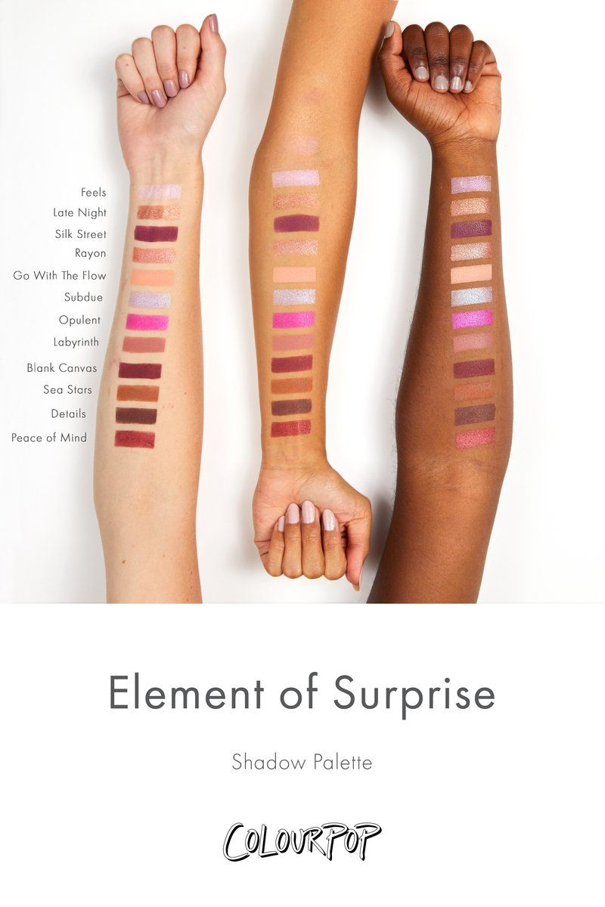
Attracting and Maintaining Attention
What makes effective publicity ?
Element of Surprise –

Slide 9
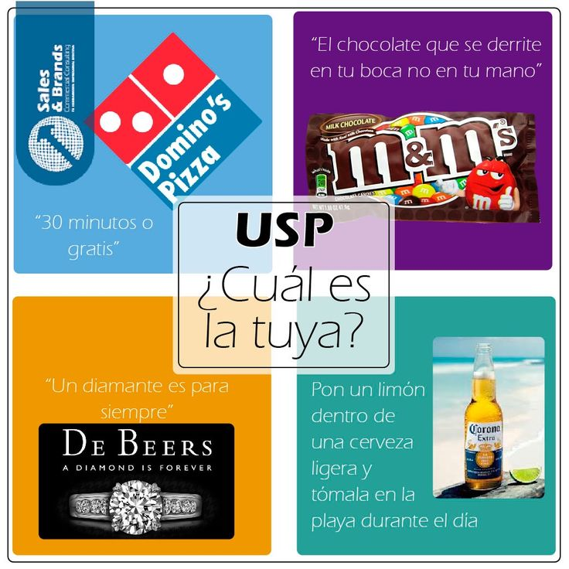
Selling Point

Slide 10
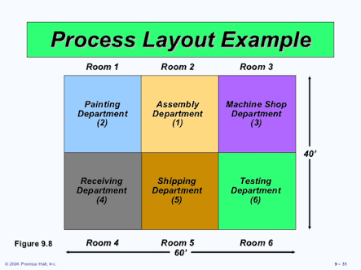
Layout

Slide 11
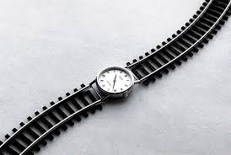
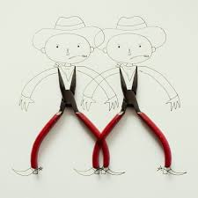
Simplicity

Slide 12
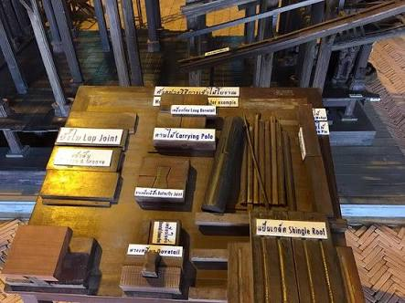
Workmanship

Slide 13
Illustrations
Books
Magazines
Catalouges
Newspapers Advertise
Posters
Clip Art
Travel Pamphlets
Coloring Books
Drawing

Slide 14
HEADLINES
90% of all viewers only read headlines
Functions of a good headlines :
To assist illustration in seizing attention
To arouse the reader’s interest
To attract target audience

Slide 15
Color
Avoid using more than 3 colors on one poster
Use basic colors for lettering
Avoid using red in limited lighting

Slide 16
Color
Feeling can be affected by the colors you choose.
Blue – Fearfulness, Tranquility
Yellow – Optimism, Inspiration
Green – Comfortableness, Refreshment, Quiet
Red – Passion, Excitement, rage, Intensity
Orange – Energetic, Forcefulness
White – Pure, Clean, Normal
Black – Formal, Elegant, Depression

Slide 17
Lettering
Only place lettering that is necessary to what needs to be said. Letters should be positioned to ensure optimum readability.
Types of lettering includes:
Speedball pen and ink
Calligraphy
Dry Transfer
Stencils
Magic Markets held at differences angles at differences angles.

Slide 18
Follow - Up
Remember to remove all publicity you have put up the day after the event has taken place. This step in the publicity process is most frequently forgotten.
When posting your publicity, it helps to make a list of the locations where you post information so the removal of “old news” is made easier for you.

Slide 19
THANK YOU

